Slide 1
Program Name goes here
Link to github Repository: GitHub
Links to trello board / project management tools: Trello
You MUST provide evidence showing how the problem has been decomposed, how the components have been developed and trialled, and of how they have been assembled and tested to create a final, working outcome.

Slide 2
Relevant Implications
Explain the relevant implications here. Please watch this video to learn how to do this.
Notes:
Explain the relevant implications here. Then as you work, develop your code, discuss how the implications are being met.

Slide 3
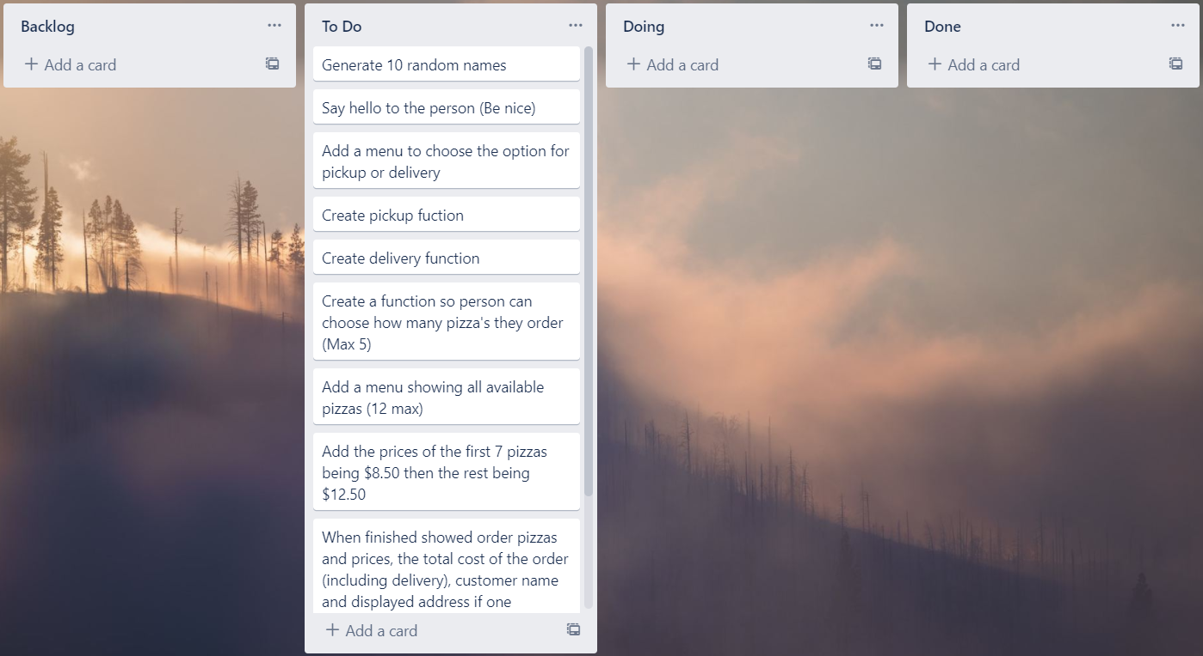
Decomposition
Paste screenshots of your initial Trello board / task decomposition on this slide. If you have a long list, you might need to break it up into several columns. Delete this instruction when you are done.
Notes:
Paste screenshots of your initial Trello board / task decomposition on this slide. If you have a long list, you might need to break it up into several columns. Delete this instruction when you are done.

Slide 4
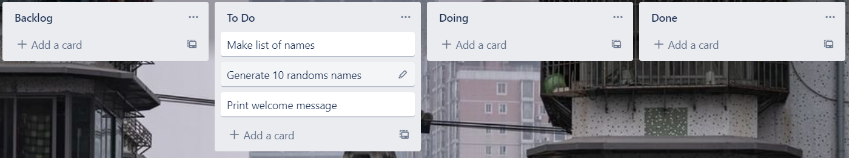
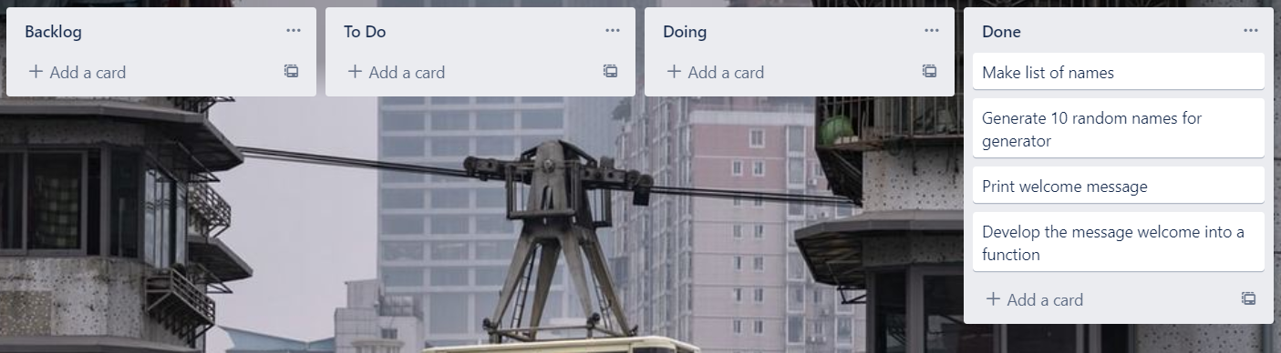
Component 1 (Trello screenshot)
Version 1
Version 2

Slide 5
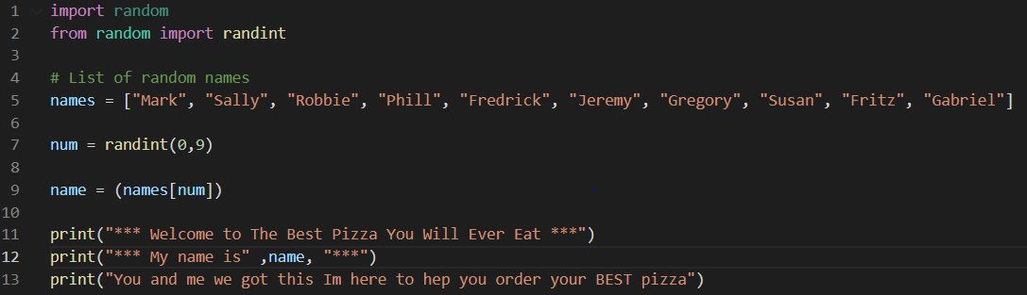
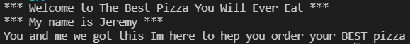
Component 1 - Test Plan (?and screenshot)
Test Case | Expected Values
Run Program | Print Welcome Message With Random Name

Slide 6
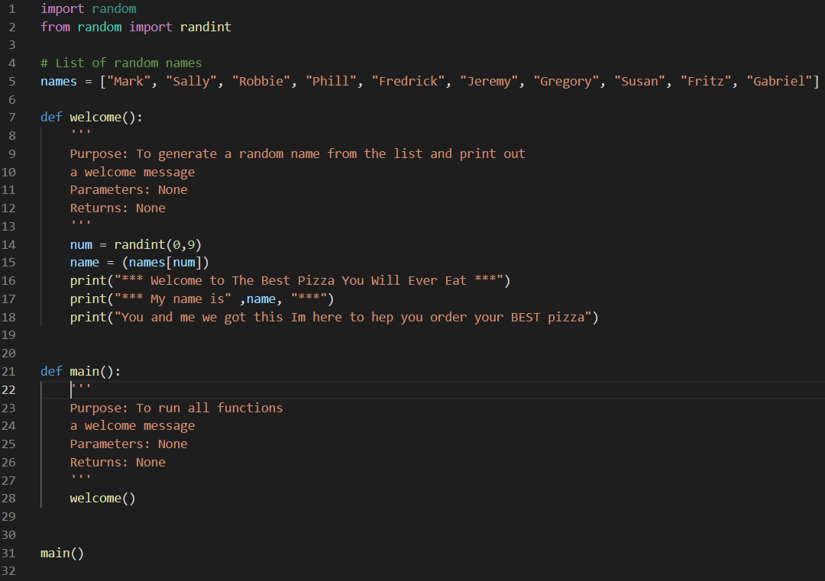
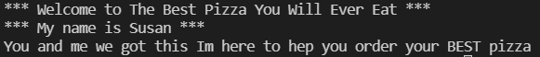
Component 1 version 2 - Test Plan (?and screenshot)
Test Case | Expected Values
Run Program | Main and Welcome run correctly. Welcome message prints with random name

Slide 7
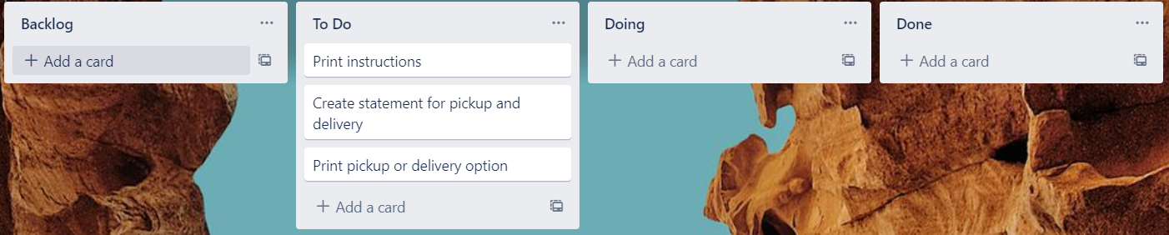
Component 2 (Trello screenshot)
Version 1
Version 2

Slide 8
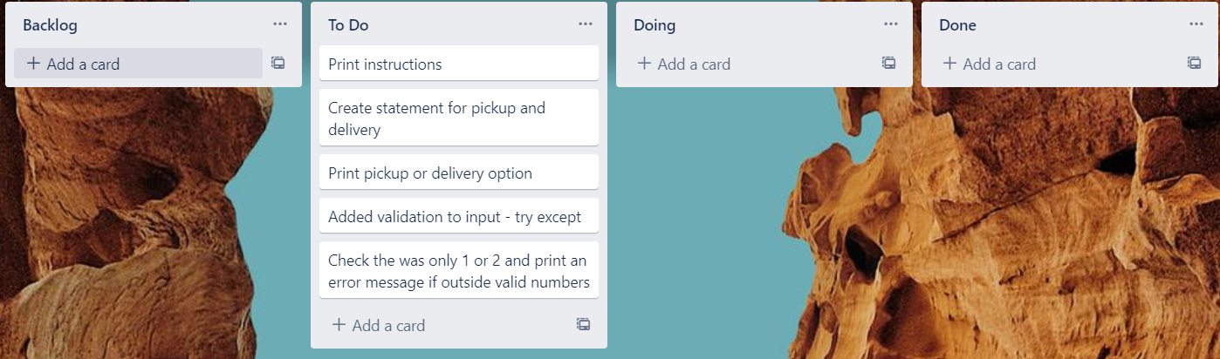
Component 2 version 2 (Trello screenshot)
Version 1
Version 2

Slide 9
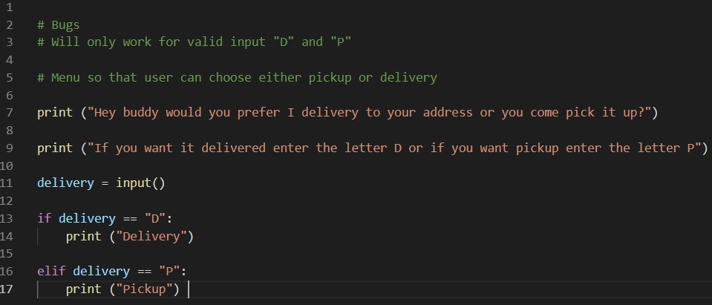
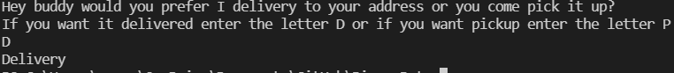
Component 2 - Test Plan (?and screenshot)
Test Case | Expected Values
Run Program | Ability to type D or P for pickup or delivery and then print messages based of input

Slide 10
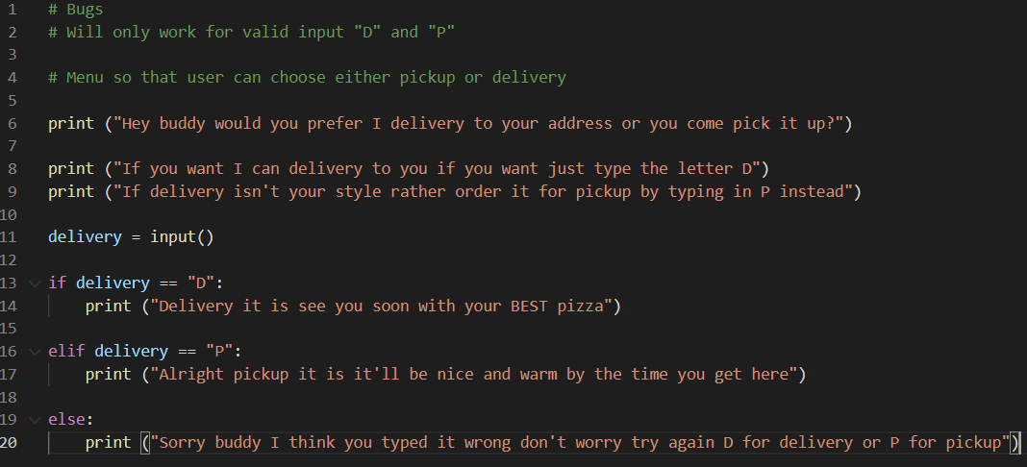
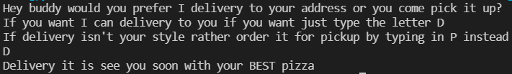
Component 2 version 2 - Test Plan (?and screenshot)
Test Case | Expected Values
Run Program | Able to order d for delivery or p for pickup with appropriate messages and another message if done incorrectely

Slide 11
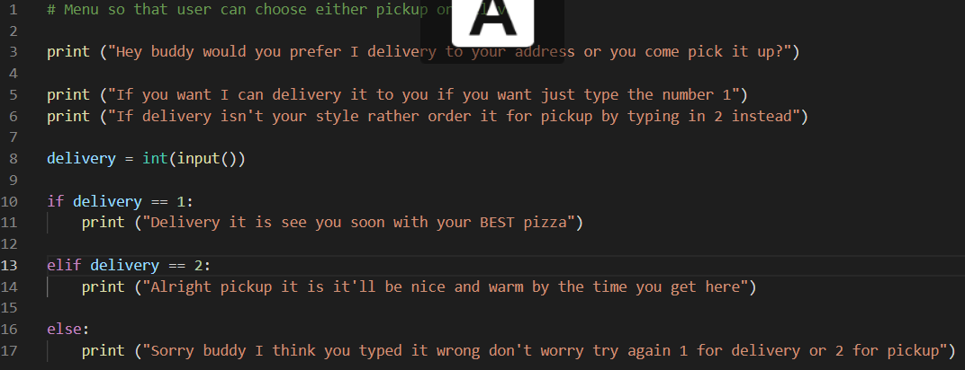
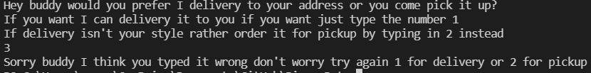
Component 2 version 3 - Test Plan (?and screenshot)
Test Case | Expected Values
Run Program | Able to order 1 for delivery or 2 for pickup rather then D or P

Slide 12
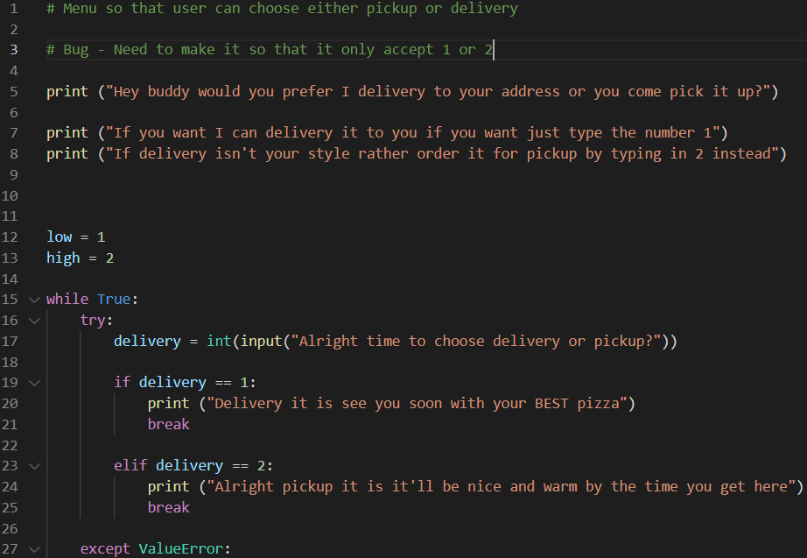
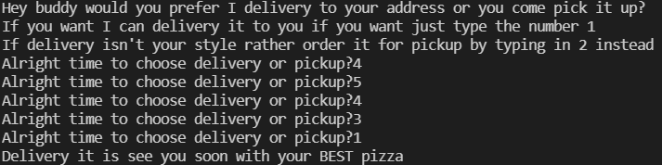
Component 2 version 4 - Test Plan (?and screenshot)
Test Case | Expected Values
Run Program | Can enter 1 for delivery or 2 for pickup, invalid response means error message but enter number other then 1 or 2 doesn't work

Slide 13
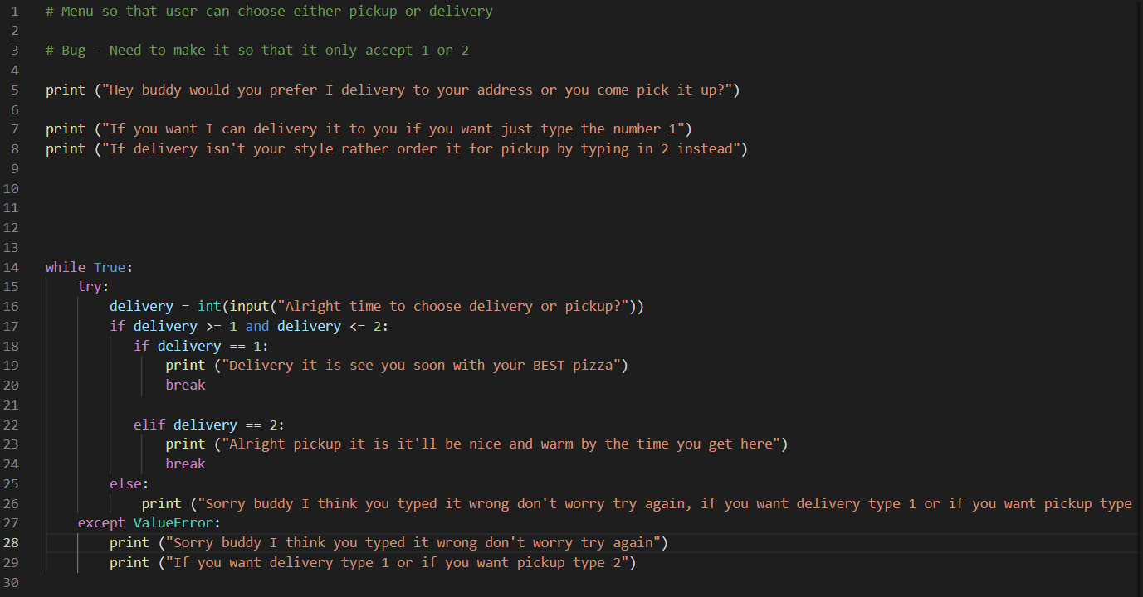
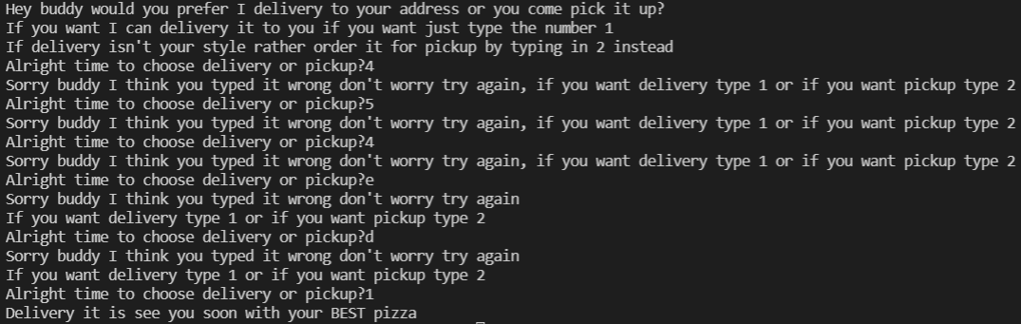
Component 2 version 5 - Test Plan (?and screenshot)
Test Case | Expected Values
Run Program | Can enter 1 for delivery or 2 for pickup, invalid response means error message and when you enter number other then 1 or 2 pops up with same error message

Slide 14
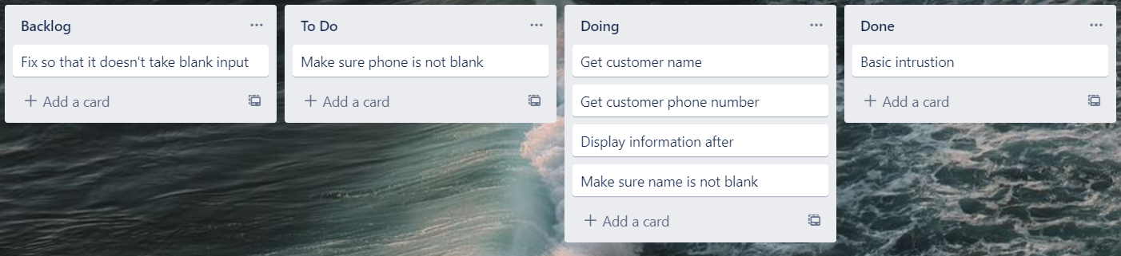
Component 3 (Trello screenshot)

Slide 15
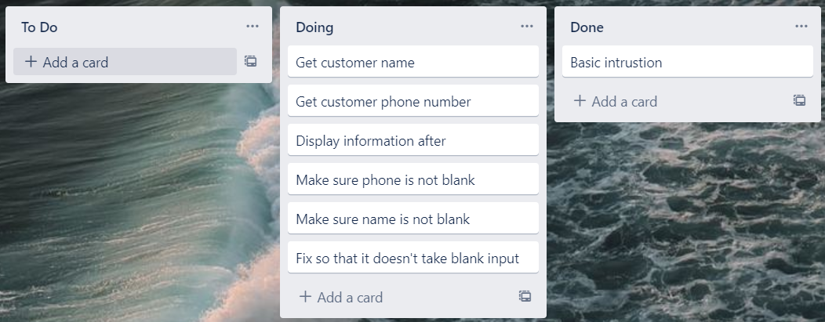
Component 3 version 2 (Trello screenshot)

Slide 16
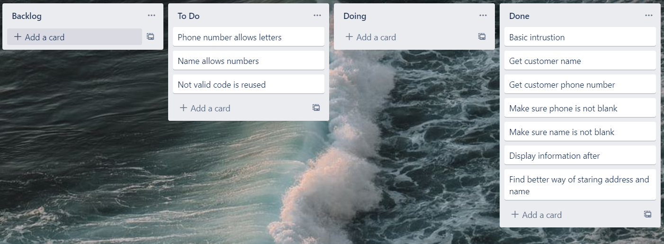
Component 3 version 3 (Trello screenshot)

Slide 17
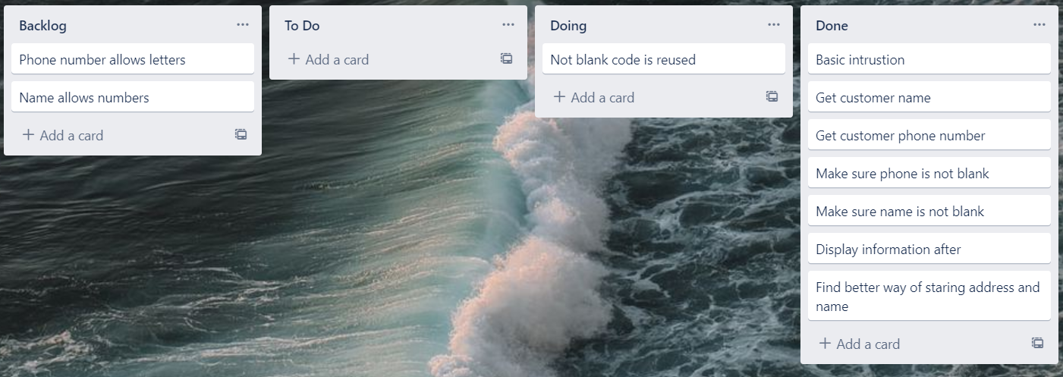
Component 3 version 4 (Trello screenshot)

Slide 18
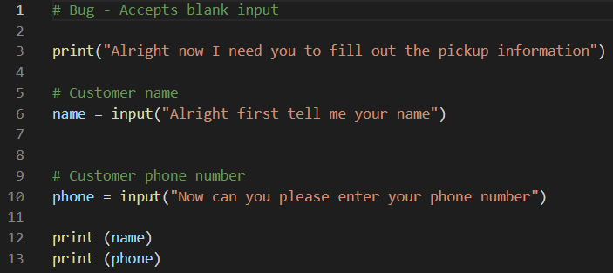
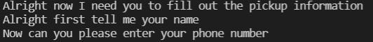
Component 3 - Test Plan (?and screenshot)
Test Case | Expected Values
Input name Input phone Left input blank | Printed name correctly Printed phone correctly Will accept blank input and will print blank

Slide 19
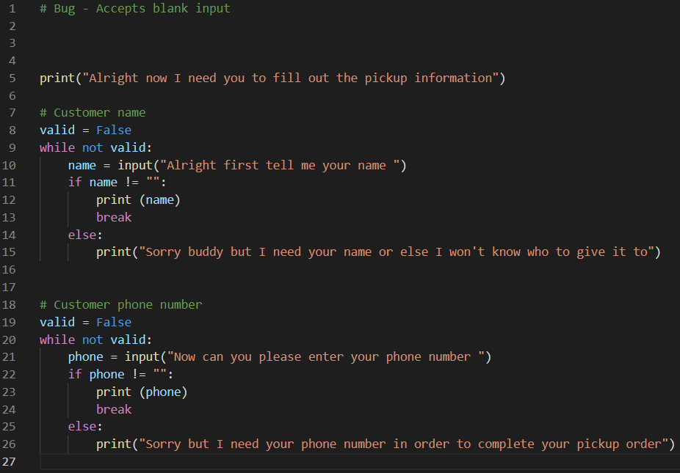
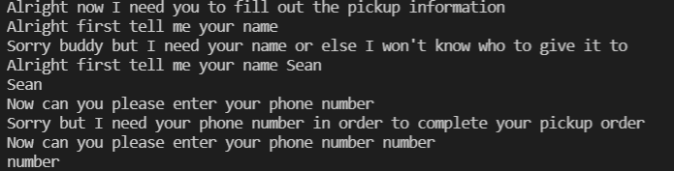
Component 3 version 2 - Test Plan (?and screenshot)
Test Case | Expected Values
Input name Input phone Left input blank | Printed name correctly Printed phone correctly Prints message saying can’t be blank

Slide 20
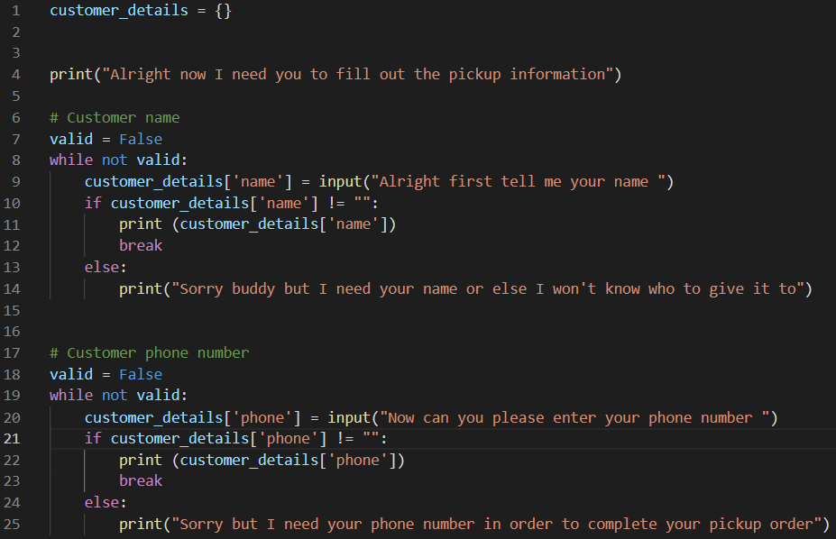
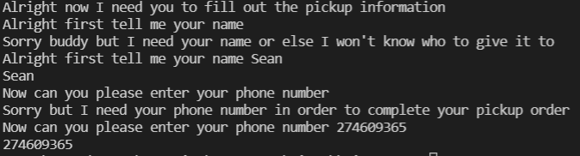
Component 3 version 3 - Test Plan (?and screenshot)
Test Case | Expected Values
Input name Input phone Left input blank | Printed name correctly Printed phone correctly Prints message saying can’t be blank

Slide 21
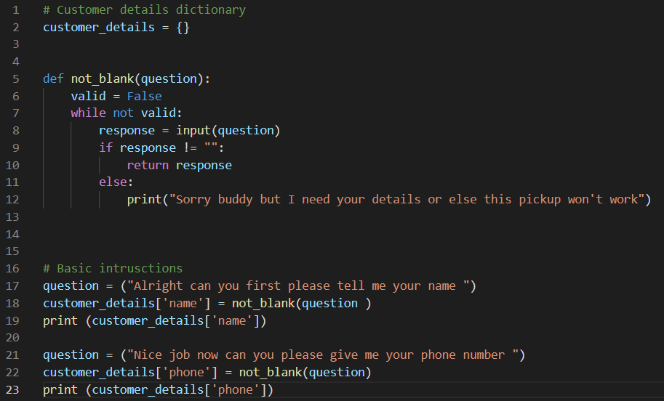
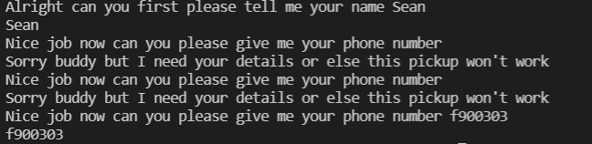
Component 3 version 4 - Test Plan (?and screenshot)
Test Case | Expected Values
Input name Input phone Left input blank | Printed name correctly Printed phone correctly Prints message saying can’t be blank

Slide 22
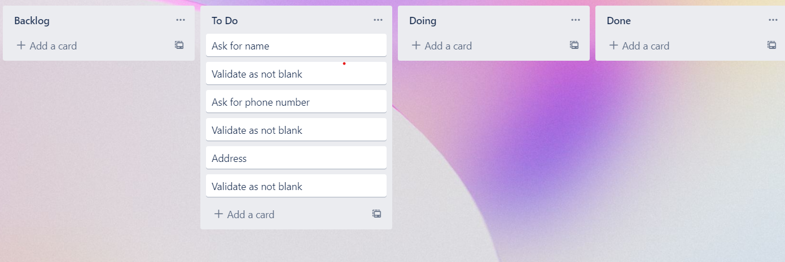
Component 4 (Trello screenshot)

Slide 23
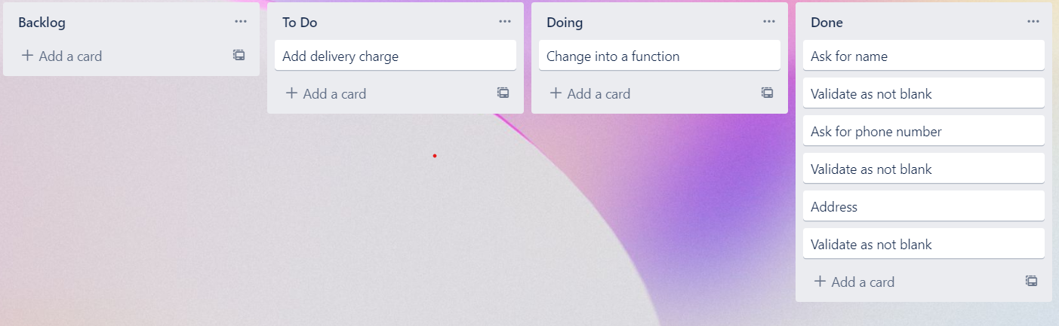
Component 4 version 2 (Trello screenshot)

Slide 24
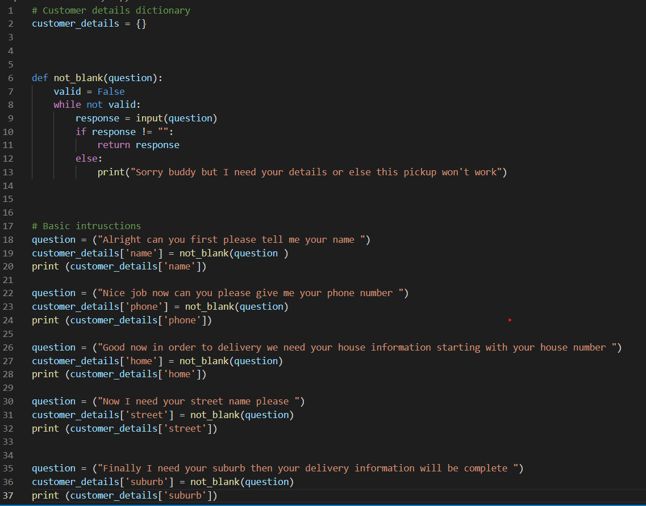
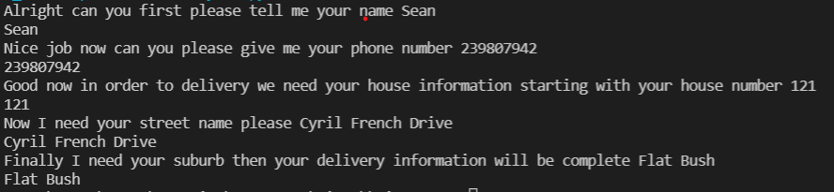
Component 4 version 1 - Test Plan (?and screenshot)
Test Case | Expected Values
Input name Input phone number Input home number Street number Suburb name Left input blank | Printed name correctly Printed phone number Accepted blank and printed blank input Printed street name Printed suburb name Asked for input again

Slide 25
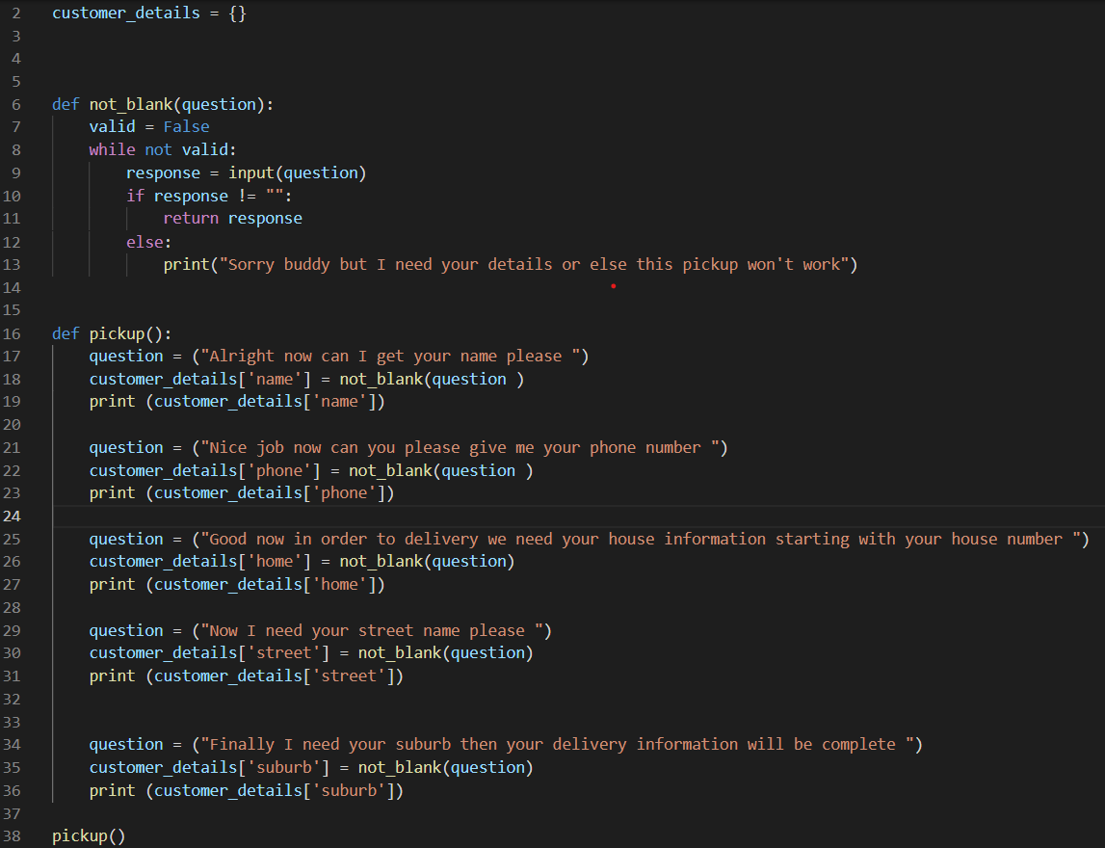
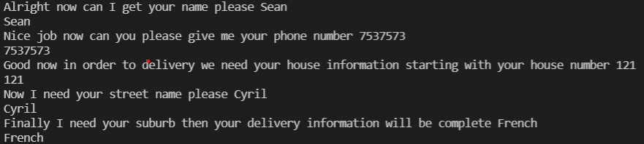
Component 4 version 2 - Test Plan (?and screenshot)
Test Case | Expected Values
Input name Input phone number Input home number Street number Suburb name Left input blank | Printed name correctly Printed phone number Printed house number Printed street name Printed suburb name Asked for input again

Slide 26
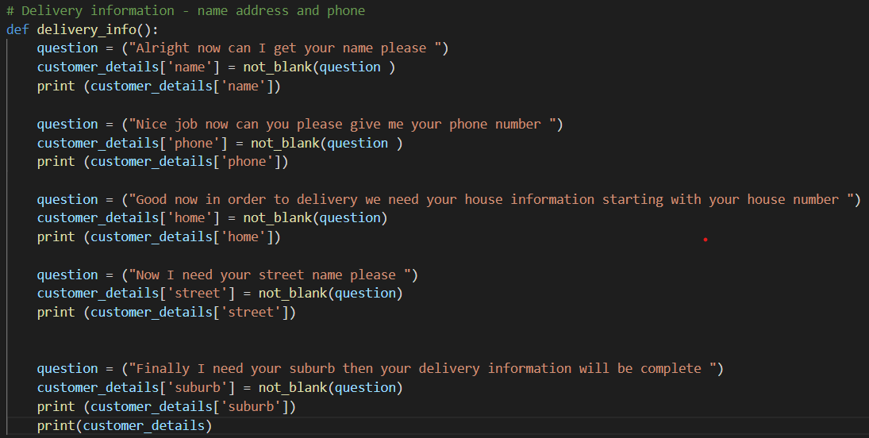
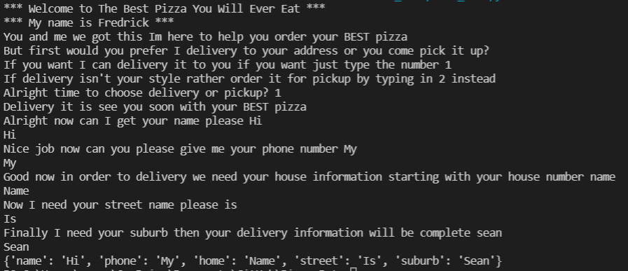
Component 4 version 3 - Test Plan (?and screenshot)
Test Case | Expected Values
Input name Input phone number Input home number Street number Suburb name Left input blank | Printed name correctly Printed phone number Printed house number Printed street name Printed suburb name Asked for input again

Slide 27
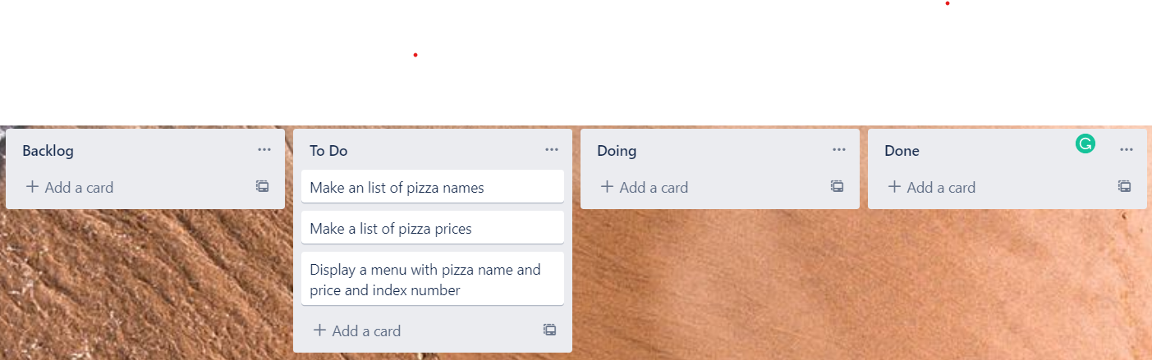
Component 5 (Trello screenshot)

Slide 28
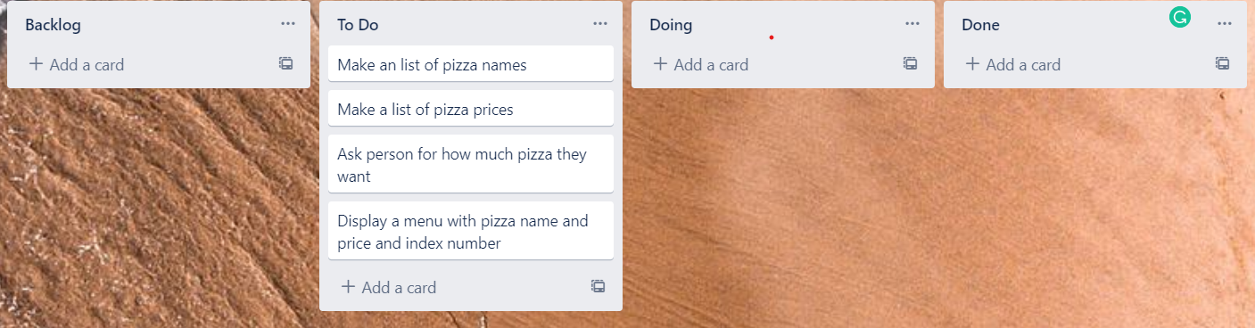
Component 5 version 2 (Trello screenshot)

Slide 29
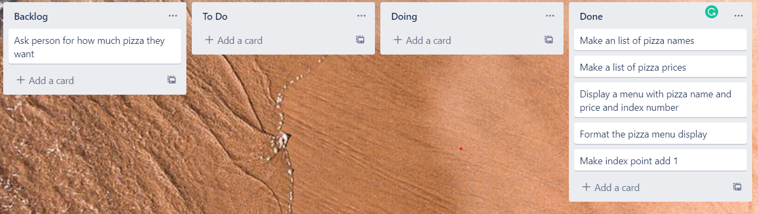
Component 5 version 3 (Trello screenshot)

Slide 30
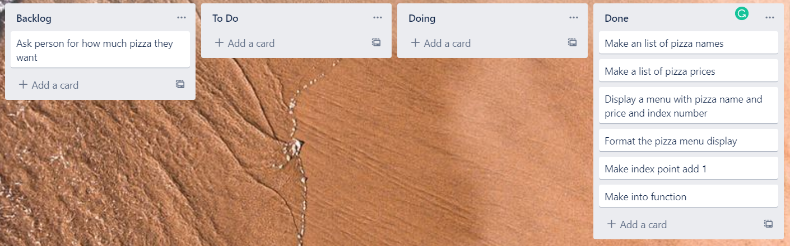
Component 5 version 4 (Trello screenshot)

Slide 31
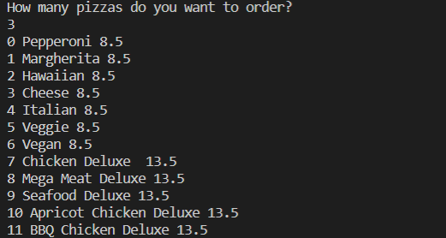
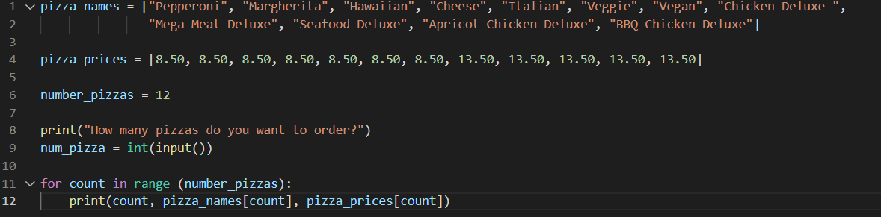
Component 5 version 1 - Test Plan (?and screenshot)
Test Case | Expected Values
Run file | Printed a list with index number, pizzas and prices

Slide 32
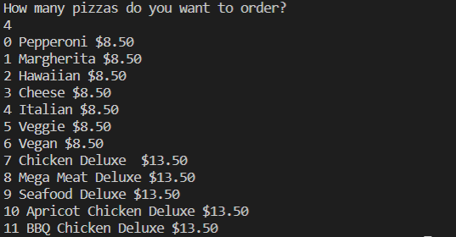
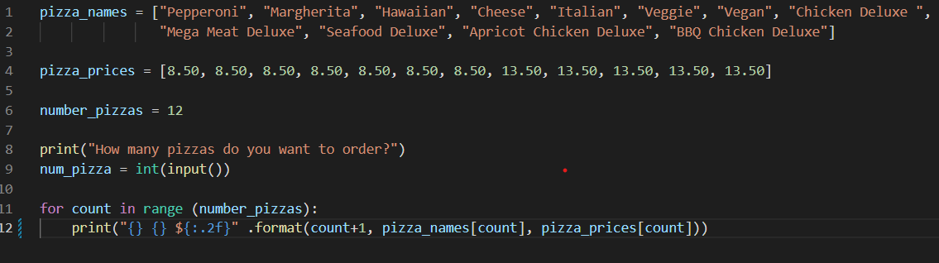
Component 5 version 2 - Test Plan (?and screenshot)
Test Case | Expected Values
Run file | Printed a list with index number, pizzas and prices With price formatted to 2 decimal places and dollar sign. Menu starts at 1

Slide 33
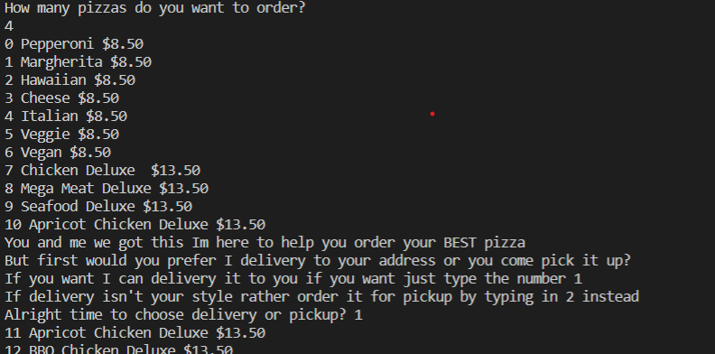
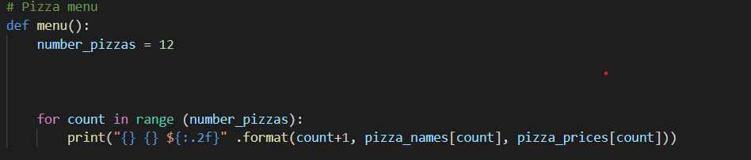
Component 5 version 3 - Test Plan (?and screenshot)
Test Case | Expected Values
Run file | Printed a list with index number, pizzas and prices With price formatted to 2 decimal places and dollar sign. Menu starts at 1

Slide 34
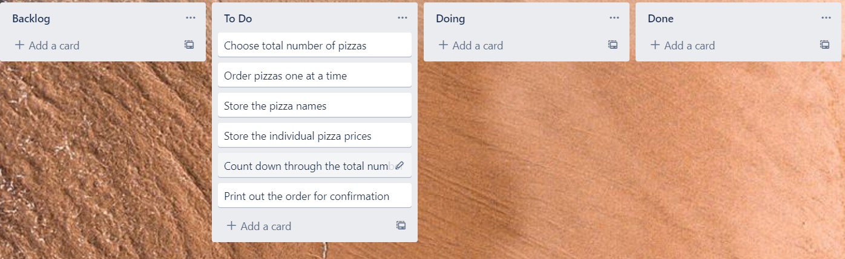
Component 6 (Trello screenshot)

Slide 35

Component 6 version 2 (Trello screenshot)

Slide 36


Component 6 - Test Plan (?and screenshot)
Test Case | Expected Values
Entered 5 pizzas Entered cat | Stepped through the menu choice 5 times Program broke

Slide 37


Component 6 version 2 - Test Plan (?and screenshot)
Test Case | Expected Values
W % Space 7 0 4 | Not valid Not valid Not valid Must be between 1 to 5 Must be between 1 to 5 Accepted

Slide 38


Component 6 version 3 - Test Plan (?and screenshot)
Test Case | Expected Values
W % Space 7 0 4 | Not valid Not valid Not valid Must be between 1 to 5 Must be between 1 to 5 Accepted

Slide 39

Component 6 version 4 - Test Plan (?and screenshot)
Test Case | Expected Values
W % Space 7 0 4 | Not valid Not valid Not valid Must be between 1 to 5 Must be between 1 to 5 Accepted

Slide 40

Component 7 (Trello screenshot)

Slide 41

Component 7 version 2 (Trello screenshot)

Slide 42

Component 7 version 3 (Trello screenshot)

Slide 43

Component 7 version 4 (Trello screenshot)

Slide 44


Component 7 - Test Plan (?and screenshot)
Test Case | Expected Values
Ran with test data | Prints correctely

Slide 45


Component 7 version 2 - Test Plan (?and screenshot)
Test Case | Expected Values
Ran with test data | Prints correctly but needs more formatting

Slide 46


Component 7 version 3 - Test Plan (?and screenshot)
Test Case | Expected Values
Ran with test data | Function prints everything probably on separate lines

Slide 47

Component 7 version 4 - Test Plan (?and screenshot)
Test Case | Expected Values
Choose pickup Choose delivery | Pickup worked – printed name and phone Delivery worked – printed name, and phone , and address

Slide 48

Component 7 version 5 - Test Plan (?and screenshot)
Test Case | Expected Values
Choose pickup Choose delivery | Pickup worked – printed name and phone Delivery worked – printed name, and phone , and address, includes delivery fee

Slide 49

Component 8 (Trello screenshot)

Slide 50

Component 8 version 2 (Trello screenshot)

Slide 51


Component 8 - Test Plan (?and screenshot)
Test Case | Expected Values
Entered 1 choose confirm Enter 2 choose canceol Entered 4 Entered s | Confirm worked to confirm order Confirm worked to cancel order Requested to ask to type 1 or 2 Doesn't work comes up with error message

Slide 52

Component 9 (Trello screenshot)

Slide 53


Component 9 - Test Plan (?and screenshot)
Test Case | Expected Values
Entered 1 choose new order Enter 2 choose exit Entered 4 Entered s | Confirm worked to start new order Confirm worked to exit Requested to ask to type 1 or 2 Doesn't work comes up with error message

Slide 54


Component 9 version 2 - Test Plan (?and screenshot)
Test Case | Expected Values
Entered 1 choose new order Enter 2 choose exit Data remains in the order | Confirm worked to start new order Confirm worked to exit Will need to clear data from these lists

Slide 55
Version Control Evidence
Your version control evidence should go here. This could be in the form of annotated screenshots which show you you managed this process or you could make a brief screencast explaining how you implemented version control.
Notes:
Your version control evidence should go here. This could be in the form of annotated screenshots which show you you managed this process or you could make a brief screencast explaining how you implemented version control.

Slide 56
Discusses how the information from planning, testing and trialling of components assisted in the development of a high-quality outcome
Notes:
Discusses how the information from planning, testing and trialling of components assisted in the development of a high-quality outcome

